Slide 1

ECE 1710: Power Distribution Engineering and Smart Grids
Lecture 6
Dr. Robert Kerestes
University of Pittsburgh
Swanson School of Engineering
Department of Electrical and Computer Engineering
Notes:
Instructions for editing school and department titles:
Select from menu: View > Master > Slide Master
Click on each text area you wish to edit. Text will become editable.

Slide 2
Outline
Lecture Outline
Module #1: Primitive and Phase Impedance Matrices for Overhead Lines
Module #2: Parallel Overhead Lines
Module #3: Parallel Overhead Lines

Slide 3
Learning Objectives
Learning Objectives:
Define the primitive impedance matrix for a transmission line
Reduce primitive impedance and potential coefficient matrices using Kron reduction
Calculate phase impedance and shunt admittance matrices using Kron reduction
Write the matrix equation for voltage drop across a transmission line

Slide 4
Primitive and Phase Impedance Matrix for Overhead Lines

Slide 5
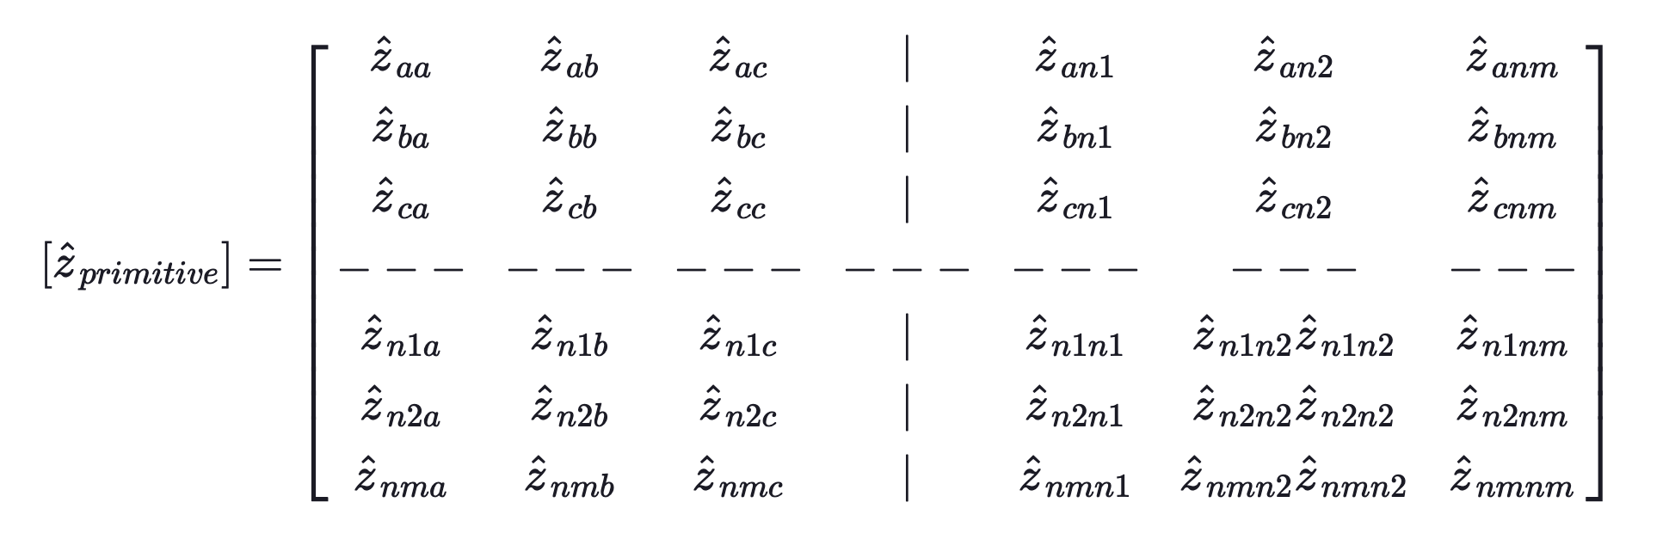
Series Impedance of Overhead Lines
The general form of a primitive impedance matrix with m neutrals is

Slide 6
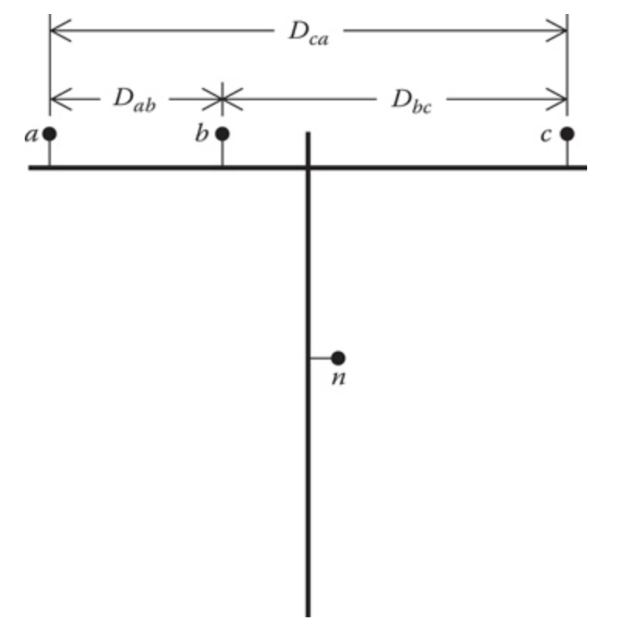
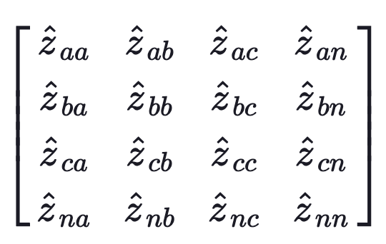
Series Impedance of Overhead Lines
An overhead four-wire grounded wye distribution line segment will result in a 4 × 4 matrix

Slide 7
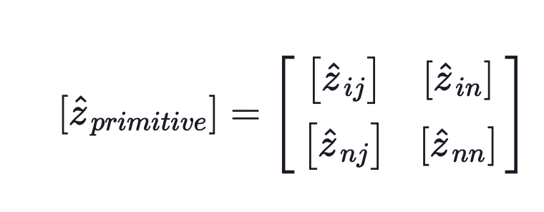
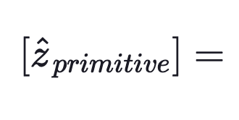
Series Impedance of Overhead Lines
In partitioned form the matrix becomes:
where:

Slide 8
Series Impedance of Overhead Lines
The submatrices for the 4 x 4 are shown in the color coded squares below
where:

Slide 9
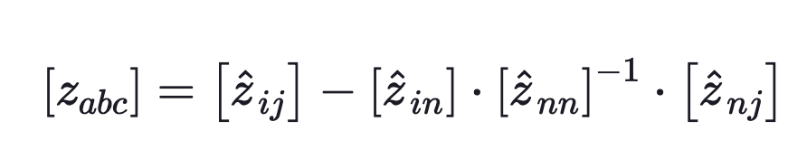
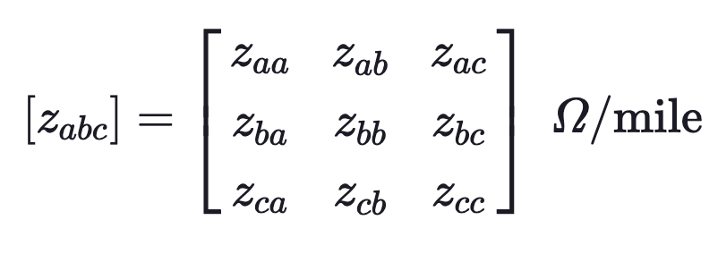
Series Impedance of Overhead Lines
The primitive impedance matrix usually has to be reduced to a 3 x 3 “phase impedance matrix”:
Which is called the Kron reduction technique, giving us

Slide 10

Series Impedance of Overhead Lines
Gabriel Kron
1901-1968
Electrical Engineer
University of Michigan
General Electric
Gabriel Kron was a Hungarian-American electrical engineer who promoted the use of methods of linear algebra, multilinear algebra, and differential geometry in the field.

Slide 11
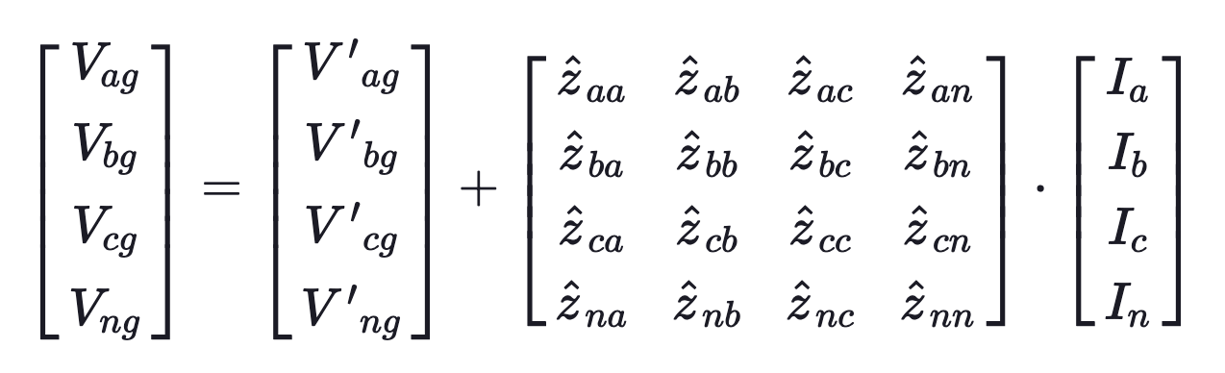
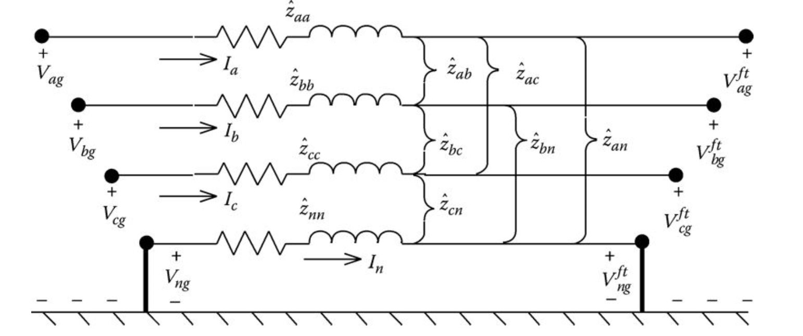
Series Impedance of Overhead Lines
This method can be used to solve the following system:

Slide 12
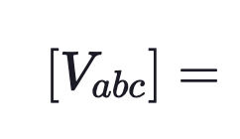
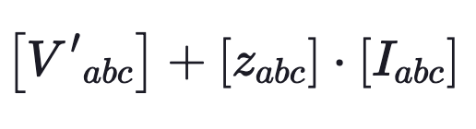
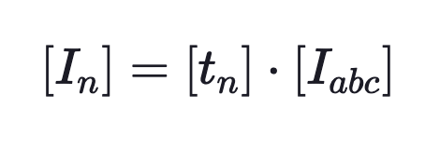
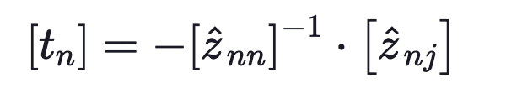
Series Impedance of Overhead Lines
With phase impedance matrices:
and:
where

Slide 13
Series Impedance of Overhead Lines
If a line is not transposed:
The diagonal elements will not be equal to each other
The off-diagonal elements will not be equal to each other
V phase and single phase connected laterals can be reduced using Kron reduction in wye-connected grounded systems
V phase have 3 x 3 primitive impedance matrices, which are reduced to 2 x 2 using Kron reduction
Single phase have 2 x 2 primitive impedance matrices, which are reduced to single element using Kron reduction

Slide 14
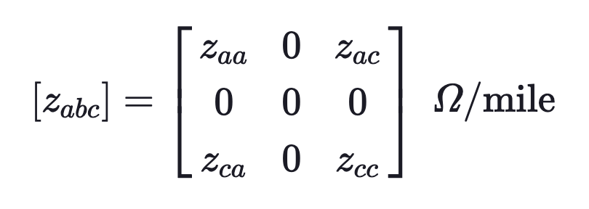
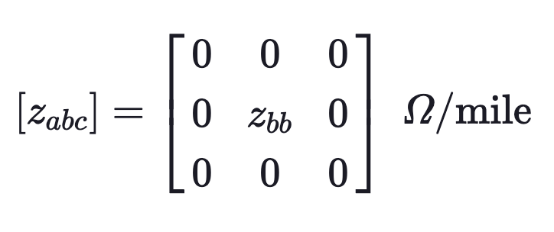
Series Impedance of Overhead Lines
For example, for a V-phase line consisting of phases a and c, the phase impedance matrix would be:
The phase impedance matrix for a phase b single-phase line would be:

Slide 15
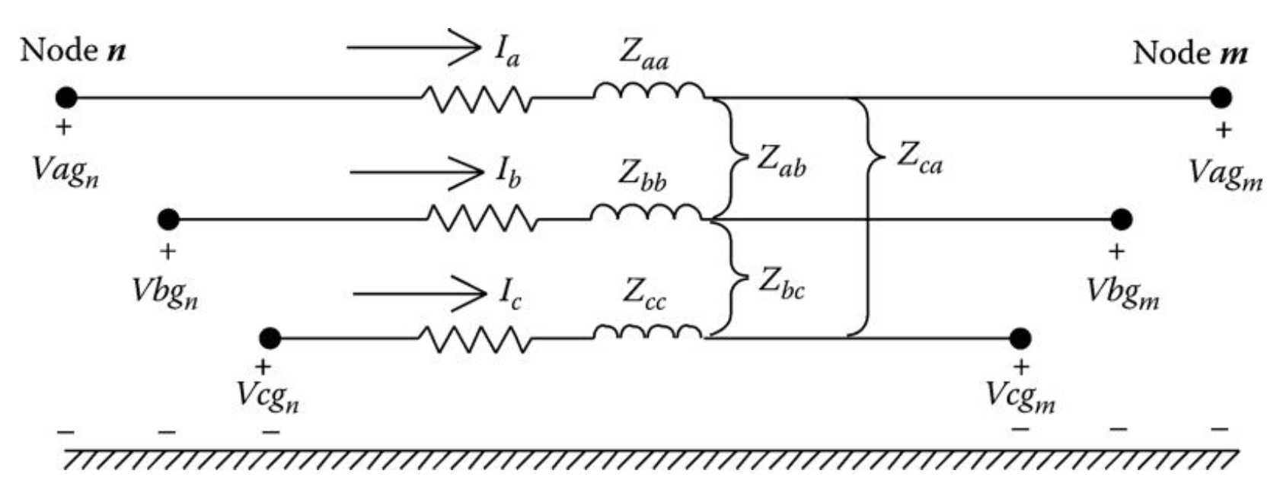
Series Impedance of Overhead Lines
The phase impedance matrix for a three-wire delta line is determined by the application of Carson's equations without the Kron reduction step.
Finally, we have the three phase line segment model using Kron reduction for wye-connected circuits, and leaving delta connected circuits in their primitive impedance matrix form.

Slide 16
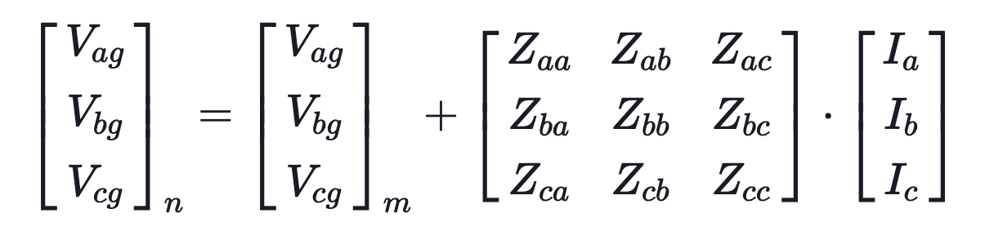
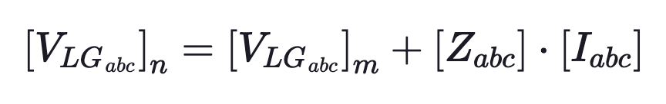
Series Impedance of Overhead Lines
The voltage equation for a line segment is then:
Or in condense form:

Slide 17
Parallel Overhead Lines

Slide 18
Parallel Overhead Lines
It is fairly common in a distribution system to find instances where two distribution lines are “physically” parallel.
The parallel combination may have both distribution lines constructed on the same pole, or the two lines may run in parallel on separate poles but on the same right-of-way.
For example, two different feeders leaving a substation may share a common pole or right-of-way before they branch out to their own service area. analyzed.

Slide 19
Parallel Overhead Lines
Two parallel lines are shown below. Note that these lines share one common neutral.

Slide 20
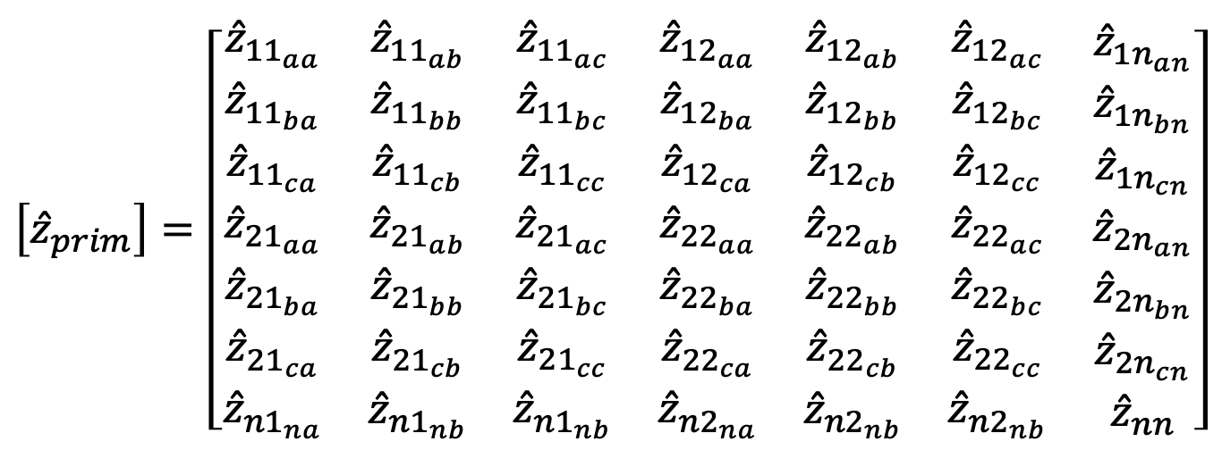
Parallel Overhead Lines
For this example, a 7 x 7 matrix would be produced where
$$\left[{\hat{z}}_{prim}\right]=\left[\begin{matrix}\begin{matrix}{\hat{z}}_{{11}_{aa}} & {\hat{z}}_{{11}_{ab}} & {\hat{z}}_{{11}_{ac}} \\ {\hat{z}}_{{11}_{ba}} & {\hat{z}}_{{11}_{bb}} & {\hat{z}}_{{11}_{bc}} \\ \begin{matrix}{\hat{z}}_{{11}_{ca}} \\ {\hat{z}}_{{21}_{aa}} \\ \begin{matrix}{\hat{z}}_{{21}_{ba}} \\ {\hat{z}}_{{21}_{ca}} \\ {\hat{z}}_{{n1}_{na}}\end{matrix}\end{matrix} & \begin{matrix}{\hat{z}}_{{11}_{cb}} \\ {\hat{z}}_{{21}_{ab}} \\ \begin{matrix}{\hat{z}}_{{21}_{bb}} \\ {\hat{z}}_{{21}_{cb}} \\ {\hat{z}}_{{n1}_{nb}}\end{matrix}\end{matrix} & \begin{matrix}{\hat{z}}_{{11}_{cc}} \\ {\hat{z}}_{{21}_{ac}} \\ \begin{matrix}{\hat{z}}_{{21}_{bc}} \\ {\hat{z}}_{{21}_{cc}} \\ {\hat{z}}_{{n1}_{nb}}\end{matrix}\end{matrix}\end{matrix} & \begin{matrix}{\hat{z}}_{{12}_{aa}} & {\hat{z}}_{{12}_{ab}} & {\hat{z}}_{{12}_{ac}} \\ {\hat{z}}_{{12}_{ba}} & {\hat{z}}_{{12}_{bb}} & {\hat{z}}_{{12}_{bc}} \\ \begin{matrix}{\hat{z}}_{{12}_{ca}} \\ {\hat{z}}_{{22}_{aa}} \\ \begin{matrix}{\hat{z}}_{{22}_{ba}} \\ {\hat{z}}_{{22}_{ca}} \\ {\hat{z}}_{{n2}_{na}}\end{matrix}\end{matrix} & \begin{matrix}{\hat{z}}_{{12}_{cb}} \\ {\hat{z}}_{{22}_{ab}} \\ \begin{matrix}{\hat{z}}_{{22}_{bb}} \\ {\hat{z}}_{{22}_{cb}} \\ {\hat{z}}_{{n2}_{nb}}\end{matrix}\end{matrix} & \begin{matrix}{\hat{z}}_{{12}_{cc}} \\ {\hat{z}}_{{22}_{ac}} \\ \begin{matrix}{\hat{z}}_{{22}_{bc}} \\ {\hat{z}}_{{22}_{cc}} \\ {\hat{z}}_{{n2}_{nb}}\end{matrix}\end{matrix}\end{matrix} & \begin{matrix}{\hat{z}}_{{1n}_{an}} \\ {\hat{z}}_{{1n}_{bn}} \\ \begin{matrix}{\hat{z}}_{{1n}_{cn}} \\ {\hat{z}}_{{2n}_{an}} \\ \begin{matrix}{\hat{z}}_{{2n}_{bn}} \\ {\hat{z}}_{{2n}_{cn}} \\ {\hat{z}}_{nn}\end{matrix}\end{matrix}\end{matrix}\end{matrix}\right]$$

Slide 21
Parallel Overhead Lines
Which can be partitioned
$$\left[{\hat{z}}_{prim}\right]=\left[\begin{matrix}\begin{matrix}{\hat{z}}_{{11}_{aa}} & {\hat{z}}_{{11}_{ab}} & {\hat{z}}_{{11}_{ac}} \\ {\hat{z}}_{{11}_{ba}} & {\hat{z}}_{{11}_{bb}} & {\hat{z}}_{{11}_{bc}} \\ \begin{matrix}{\hat{z}}_{{11}_{ca}} \\ {\hat{z}}_{{21}_{aa}} \\ \begin{matrix}{\hat{z}}_{{21}_{ba}} \\ {\hat{z}}_{{21}_{ca}} \\ {\hat{z}}_{{n1}_{na}}\end{matrix}\end{matrix} & \begin{matrix}{\hat{z}}_{{11}_{cb}} \\ {\hat{z}}_{{21}_{ab}} \\ \begin{matrix}{\hat{z}}_{{21}_{bb}} \\ {\hat{z}}_{{21}_{cb}} \\ {\hat{z}}_{{n1}_{nb}}\end{matrix}\end{matrix} & \begin{matrix}{\hat{z}}_{{11}_{cc}} \\ {\hat{z}}_{{21}_{ac}} \\ \begin{matrix}{\hat{z}}_{{21}_{bc}} \\ {\hat{z}}_{{21}_{cc}} \\ {\hat{z}}_{{n1}_{nb}}\end{matrix}\end{matrix}\end{matrix} & \begin{matrix}{\hat{z}}_{{12}_{aa}} & {\hat{z}}_{{12}_{ab}} & {\hat{z}}_{{12}_{ac}} \\ {\hat{z}}_{{12}_{ba}} & {\hat{z}}_{{12}_{bb}} & {\hat{z}}_{{12}_{bc}} \\ \begin{matrix}{\hat{z}}_{{12}_{ca}} \\ {\hat{z}}_{{22}_{aa}} \\ \begin{matrix}{\hat{z}}_{{22}_{ba}} \\ {\hat{z}}_{{22}_{ca}} \\ {\hat{z}}_{{n2}_{na}}\end{matrix}\end{matrix} & \begin{matrix}{\hat{z}}_{{12}_{cb}} \\ {\hat{z}}_{{22}_{ab}} \\ \begin{matrix}{\hat{z}}_{{22}_{bb}} \\ {\hat{z}}_{{22}_{cb}} \\ {\hat{z}}_{{n2}_{nb}}\end{matrix}\end{matrix} & \begin{matrix}{\hat{z}}_{{12}_{cc}} \\ {\hat{z}}_{{22}_{ac}} \\ \begin{matrix}{\hat{z}}_{{22}_{bc}} \\ {\hat{z}}_{{22}_{cc}} \\ {\hat{z}}_{{n2}_{nb}}\end{matrix}\end{matrix}\end{matrix} & \begin{matrix}{\hat{z}}_{{1n}_{an}} \\ {\hat{z}}_{{1n}_{bn}} \\ \begin{matrix}{\hat{z}}_{{1n}_{cn}} \\ {\hat{z}}_{{2n}_{an}} \\ \begin{matrix}{\hat{z}}_{{2n}_{bn}} \\ {\hat{z}}_{{2n}_{cn}} \\ {\hat{z}}_{nn}\end{matrix}\end{matrix}\end{matrix}\end{matrix}\right]$$

Slide 22
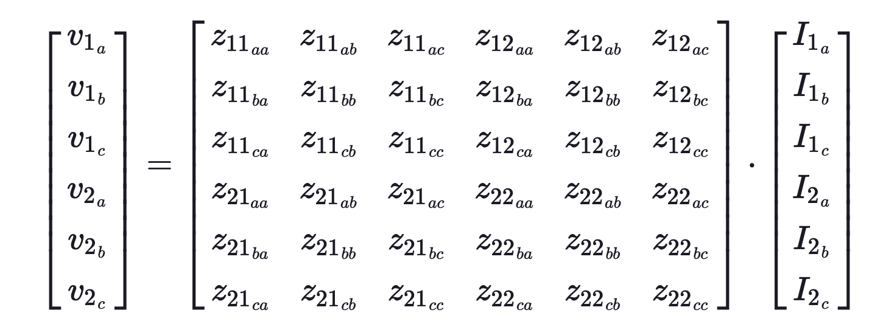
Parallel Overhead Lines
Then using the Kron reduction we have

Slide 23
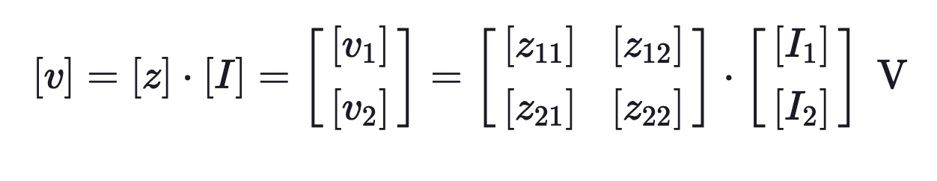
Parallel Overhead Lines
And the voltage drop equation will be

Slide 24
Concentric Neutral Cable
Module #1

Slide 25
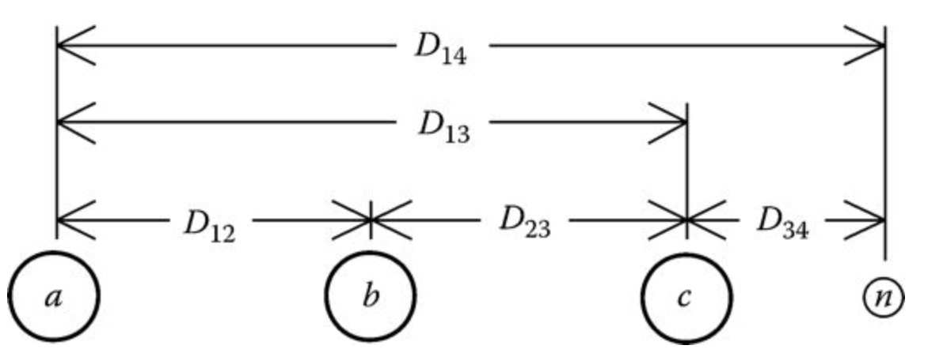
Concentric Neutral Cable
Module #1
Shown below is the general configuration of three underground cables (concentric neutral or tape-shielded) with an additional neutral conductor.

Slide 26
Concentric Neutral Cable
Module #1
There are two popular types of underground cables
Concentric neutral cable
Tape shield cable

Slide 27
Concentric Neutral Cable
Module #1
There are two popular types of underground cables
Concentric neutral cable
Tape shield cable
Underground circuits will produce a 7 x 7 primitive impedance matrix if there is a neutral and a 6 x 6 if there is not a neutral

Slide 28
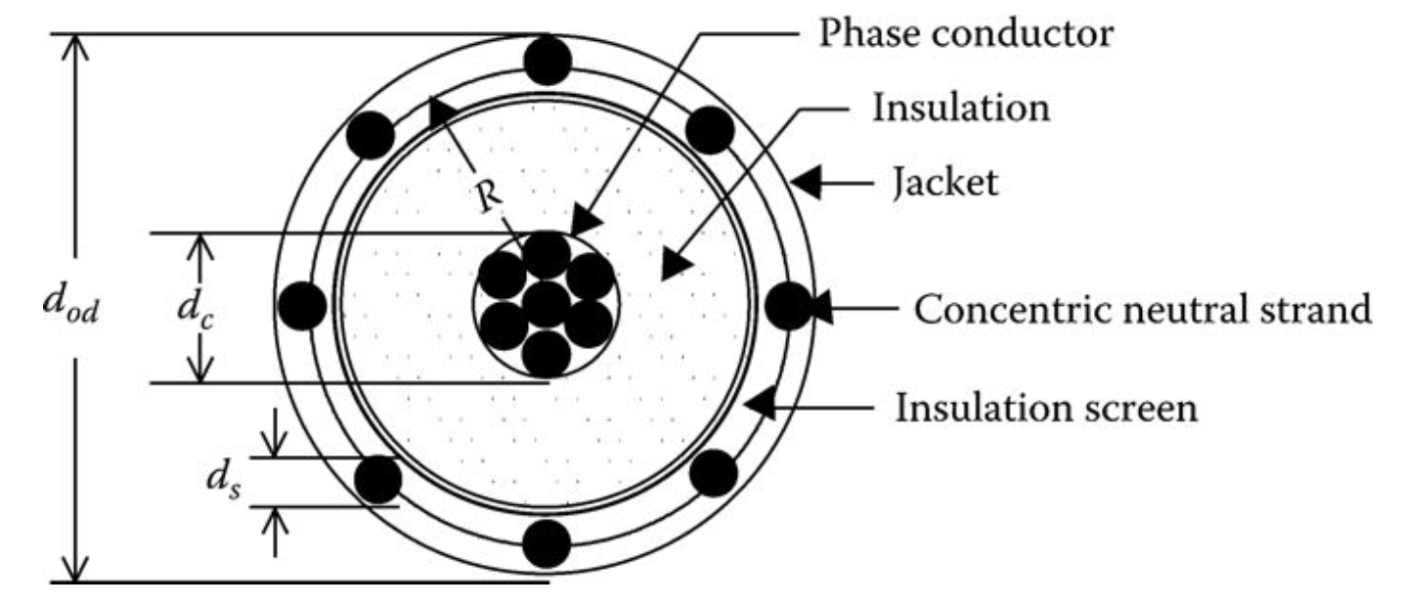
Concentric Neutral Cable
Module #1
Shown below is a drawing of a concentric neutral cable

Slide 29
Concentric Neutral Cable
Module #1
In order to apply Carson’s equations to this cable, the following data needs to be extracted from a table of underground cables (Appendices A and B).
d_{c} = phase conductor diameter (in.)
d_{od} = nominal diameter over the concentric neutrals of the cable (in.)
d_{s} = diameter of a concentric neutral strand (in.)
GMR_{c} = geometric mean radius of the phase conductor (ft)
GMR_{s} = geometric mean radius of a neutral strand (ft)
r_{c} = resistance of the phase conductor (Ω/mile)
r_{s} = resistance of a solid neutral strand (Ω/mile)
k = number of concentric neutral strands

Slide 30
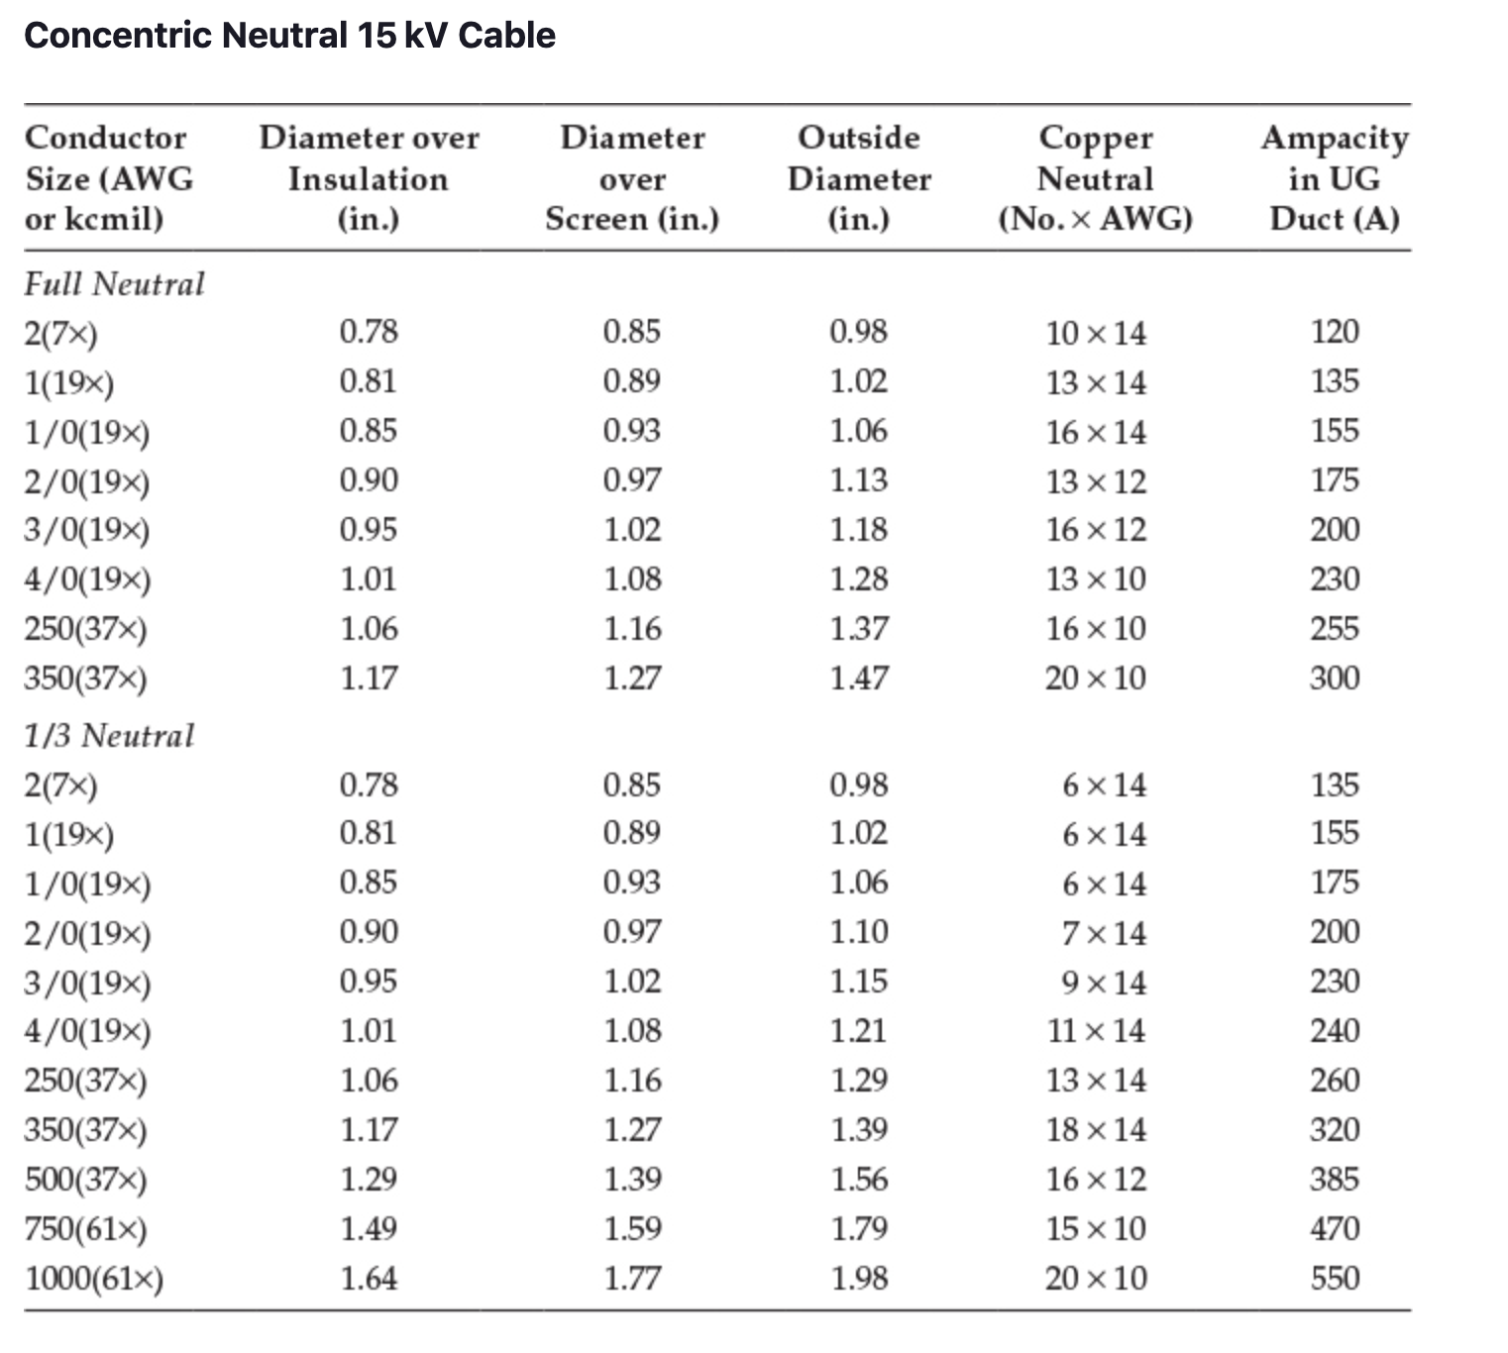
Module #1

Slide 31
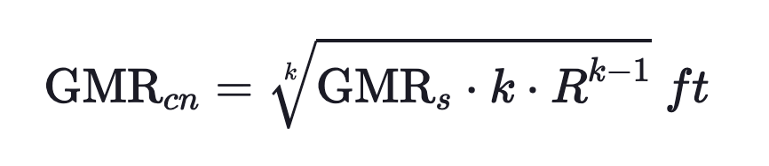
Concentric Neutral Cable
Module #1
The GMRs of the phase conductor and a neutral strand are obtained from a standard table of conductor data (Appendix A).
The equivalent GMR of the concentric neutral is computed using the equation for the GMR of bundled conductors used in high-voltage transmission lines:

Slide 32
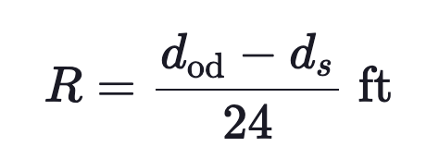
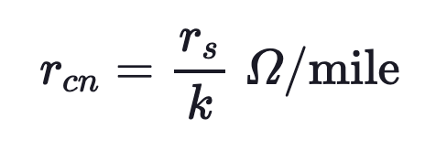
Concentric Neutral Cable
Module #1
R = radius of a circle passing through the center of the concentric neutral strands
The equivalent resistance of the concentric neutral is:

Slide 33
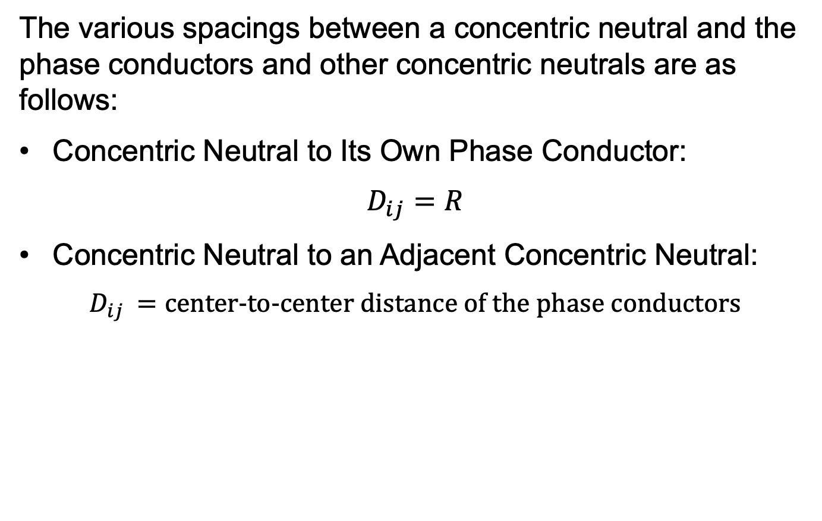
Concentric Neutral Cable
Module #1
The various spacings between a concentric neutral and the phase conductors and other concentric neutrals are as follows:
Concentric Neutral to Its Own Phase Conductor:
$$D_{ij}=R$$
Concentric Neutral to an Adjacent Concentric Neutral:
$$D_{ij }=\text{center}\text{−}\text{to}\text{−}\text{center} \text{distance} \text{of} \text{the} \text{phase} \text{conductors}$$

Slide 34
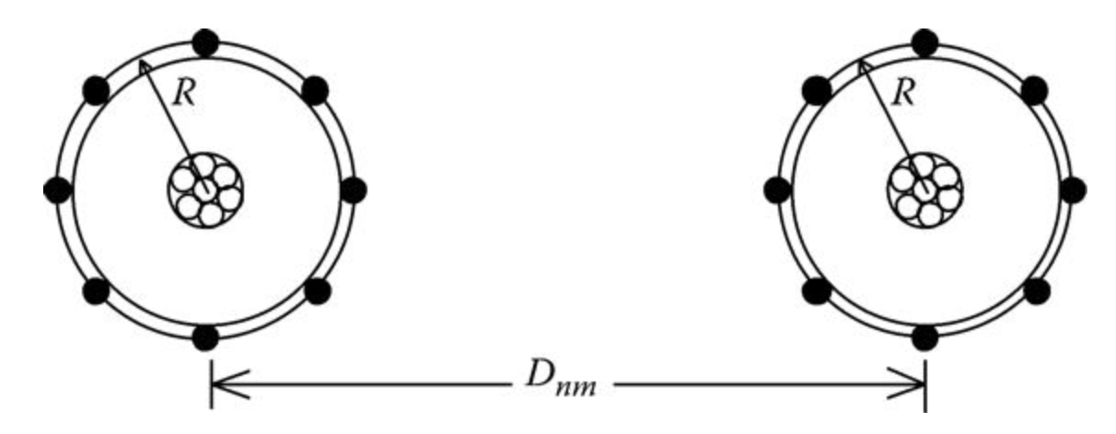
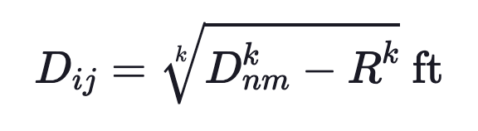
Concentric Neutral Cable
Module #1
Concentric Neutral to an Adjacent Phase Conductor

Slide 35
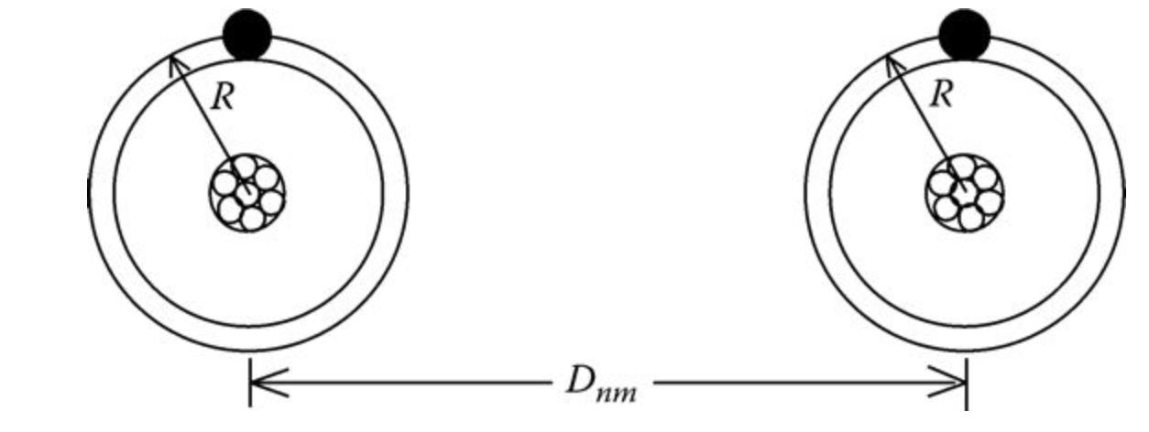
Concentric Neutral Cable
Module #1
The distance between cables will be much greater than the radius R; so a good approximation of modeling the concentric neutral cables is shown in below. In this figure, the concentric neutrals are modeled as one equivalent conductor (shown in black) directly above the phase conductor.

Slide 36
Concentric Neutral Cable
Module #1
n applying the Modified Carson’s Equations, the numbering of conductors and neutrals is important. For example, a three-phase underground circuit with an additional neutral conductor must be numbered as:
1 = phase a Conductor #1
2 = phase b Conductor #2
3 = phase c Conductor #3
4 = neutral of Conductor #1
5 = neutral of Conductor #2
6 = neutral of Conductor #3
7 = additional neutral conductor (if present)

Slide 37
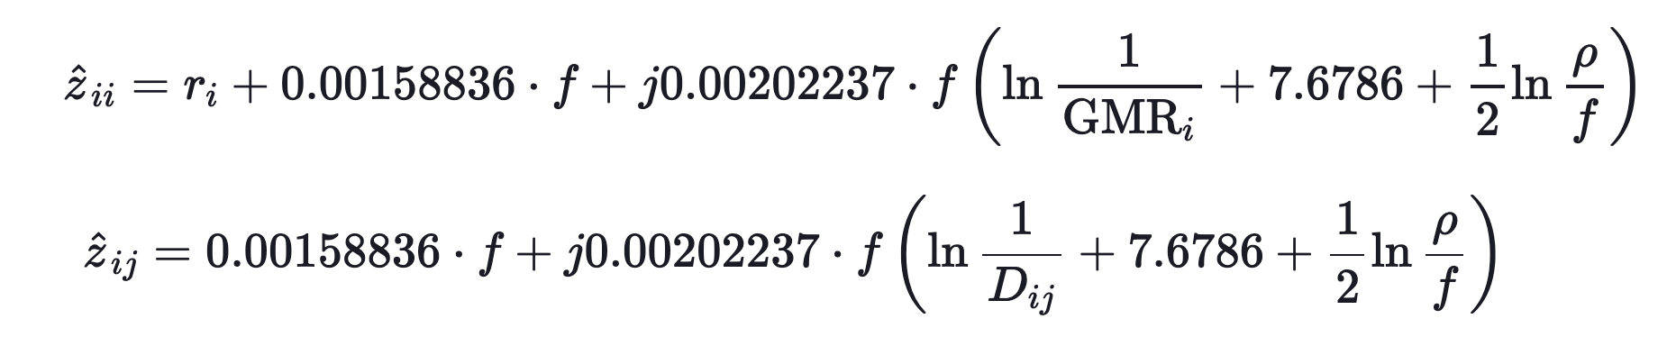
Concentric Neutral Cable
Module #1
Recall modified Carson’s equations are:

Slide 38
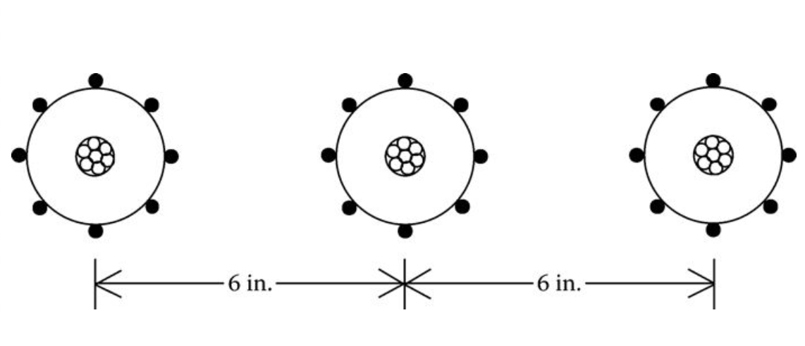
Concentric Neutral Example
Module #2
Three concentric neutral cables are buried in a trench with spacings as shown in the figure below
The cables are 15 kV, 250,000 CM stranded all aluminum with k = 13 strands of #14 annealed coated copper wires (1/3 neutral). The outside diameter of the cable over the neutral strands is 1.29 in. Determine the phase impedance matrix and the sequence impedance matrix.

Slide 39
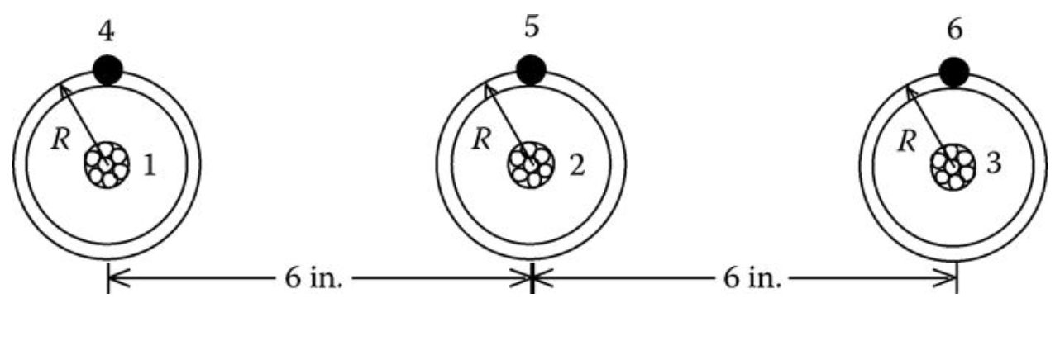
Concentric Neutral Example
Module #2
The equivalent model for these cables is shown below

Slide 40
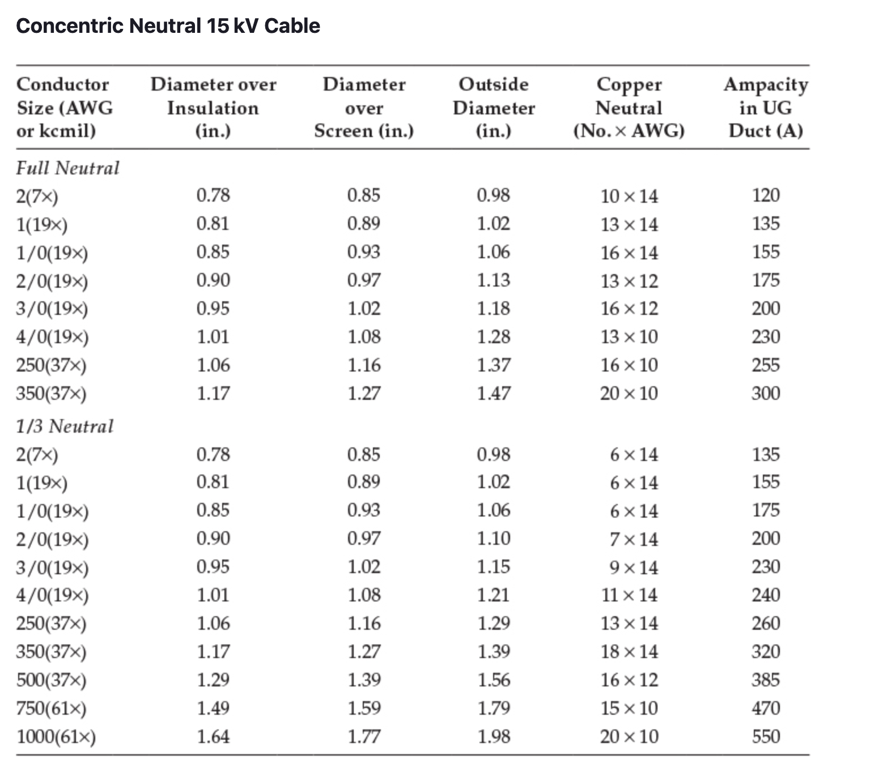
Module #2

Slide 41
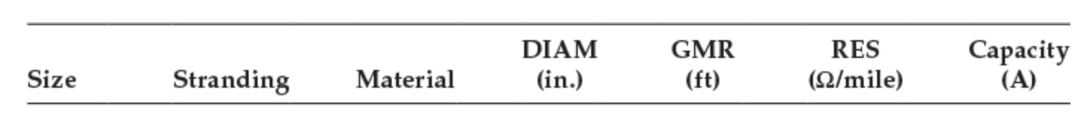
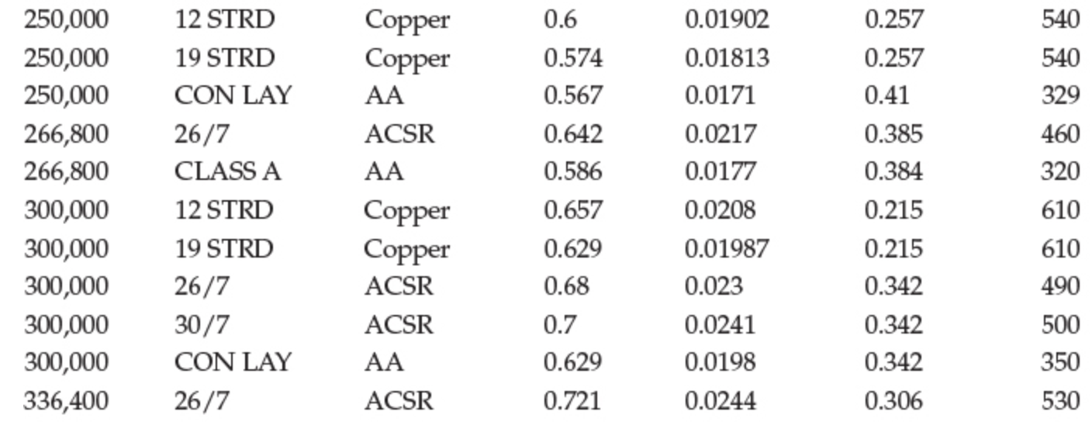
Module #2

Slide 42
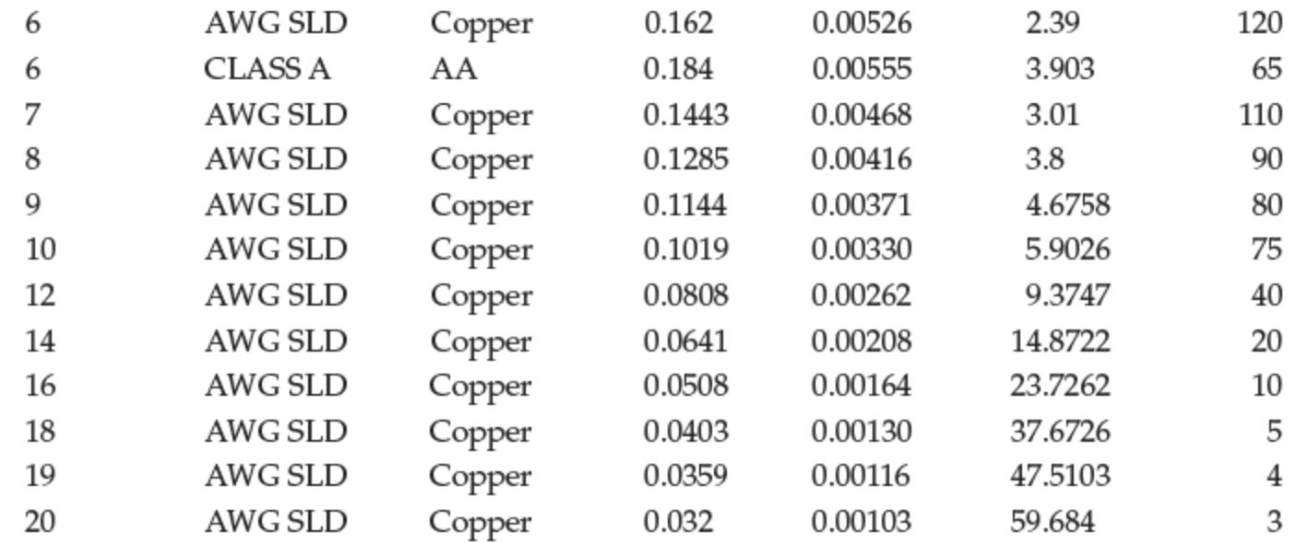
Module #2

Slide 43
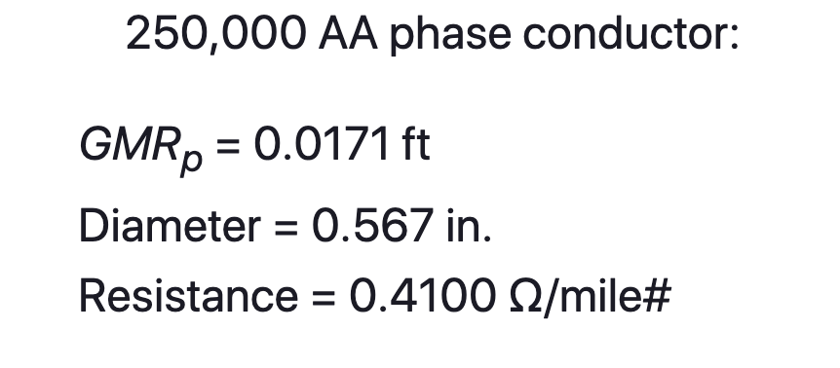
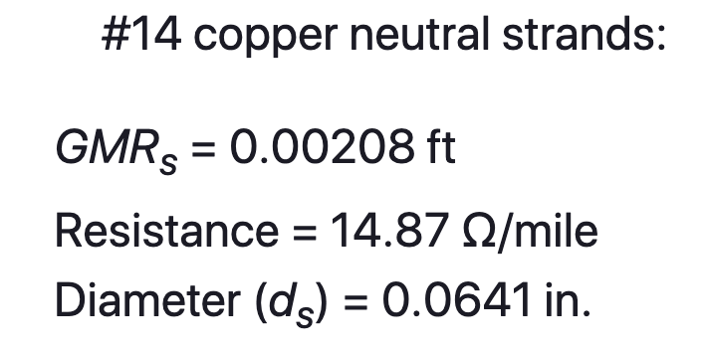
Concentric Neutral Example
Module #2
The data for the phase and neutral conductors is

Slide 44
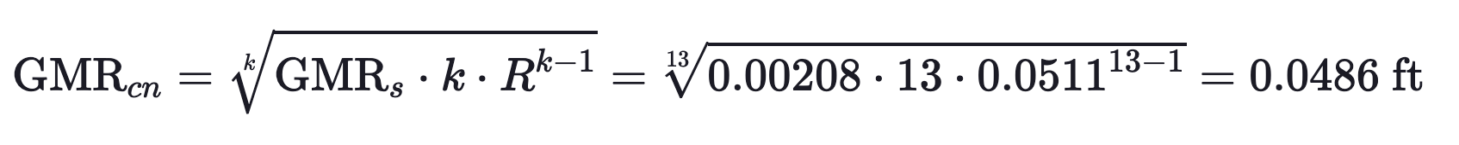
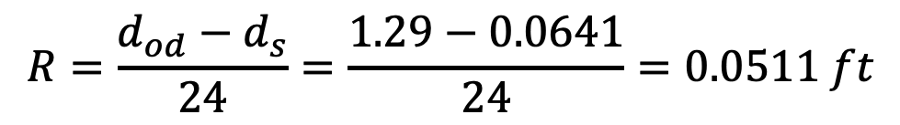
Concentric Neutral Example
Module #2
We then can calculate radius of the circle passing through the center of the strands
$$R=\frac{d_{od}−d_{s}}{24}=\frac{1.29−0.0641}{24}=0.0511 ft$$
Then using that to calculate the equivalent GMR

Slide 45
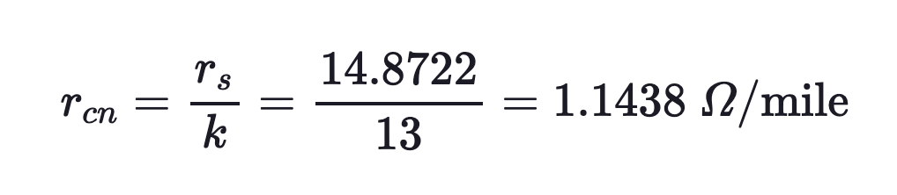
Concentric Neutral Example
Module #2
Calculating the equivalent resistance for the concentric neutral conductor

Slide 46
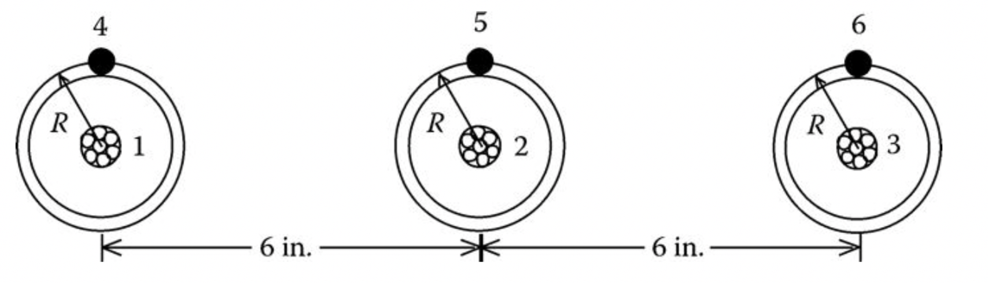
Concentric Neutral Example
Module #2
The coordinates for the conductors can be defined where the center of the phase conductors are at a y-coordinate of 0. Centering the center conductor
(0.5,0)
(-0.5,0)
(0,0)

Slide 47
Concentric Neutral Example
Module #2
The neutrals use the equivalent resistance and equivalent GMR are used for the concentric neutrals.
Modified Carson’s equations can then be used to solve for the impedance elements of the primitive impedance matrix.

Slide 48
Concentric Neutral Example
Module #2
Below is the output of a MATLAB Script which calculates the primitive impedance matrix.

Slide 49
Concentric Neutral Example
Module #2
Applying the Kron reduction yields

Slide 50
Module #3
Tape-Shielded Cables

Slide 51
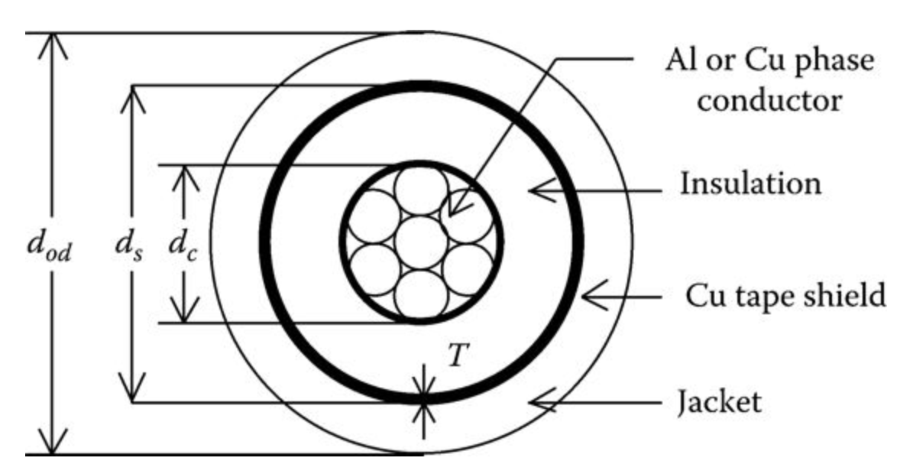
Tape-Shielded Cables
Module #3
The figure below shows a simple detail of a tape-shielded cable.

Slide 52
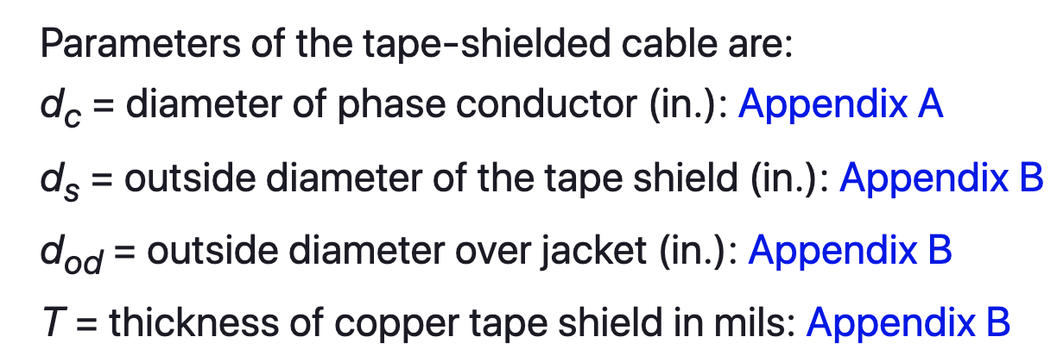
Tape-Shielded Cables
Module #3
For the tape shielded cable

Slide 53
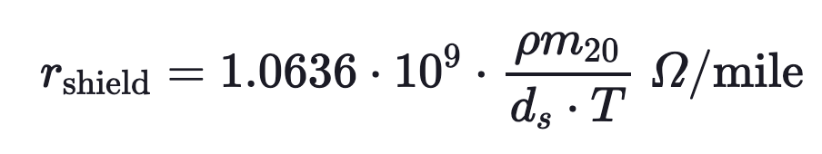
Tape-Shielded Cables
Module #3
The resistance of the tape shield is given by:
This resistance of the tape shield given assumes a resistivity (ρm₂₀) of 1.7721 · 10⁻⁸ Ω-m and a temperature of 20°C. The outside diameter of the tape shield ds is given in inches, and the thickness of the tape shield T is in mils.

Slide 54
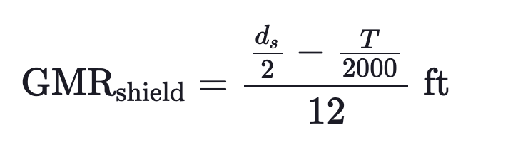
Tape-Shielded Cables
Module #3
The GMR of the tape shield is the radius of a circle passing through the middle of the shield and is given by:

Slide 55
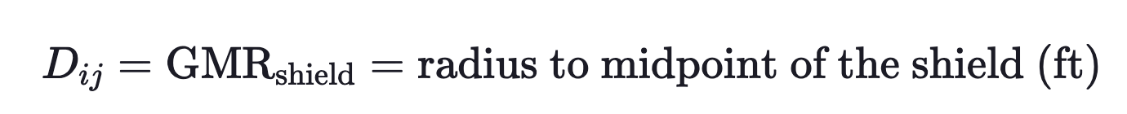
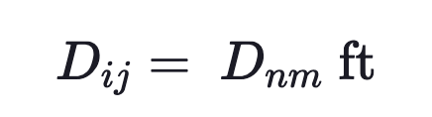
Tape-Shielded Cables
Module #3
Tape Shield to its Own Phase Conductor
Tape Shield to an Adjacent Tape Shield
Tape Shield to an Adjacent Phase or Neutral Conductor
where D_{nm} = center-to-center distance between phase conductors.

Slide 56

Tape-Shielded Cables
Module #3
Example: A single-phase circuit consists of a 1/0 AA, 220 mil insulation tape-shielded cable and a 1/0 CU neutral conductor. The single-phase line is connected to phase b. Determine the phase impedance matrix.

Slide 57

Tape-Shielded Cables
Module #3

Slide 58


Tape-Shielded Cables
Module #3

Slide 59

Tape-Shielded Cables
Module #3
For the phase conductor

Slide 60
Tape-Shielded Cables
Module #3

Slide 61

Tape-Shielded Cables
Module #3
For the neutral

Slide 62


Tape-Shielded Cables
Module #3
The basic calculations are:
Resistance of the tape shield
GMR of the tape shield

Slide 63

Tape-Shielded Cables
Module #3
The conductors are numbered such that:
#1 = 1/0 AA conductor
#2 = tape shield
#3 = 1/0 copper ground

Slide 64


Tape-Shielded Cables
Module #3
Then just use Carson’s equations to get
Partitioned as

Slide 65


Tape-Shielded Cables
Module #3
And performing the Kron reduction

Slide 66

Tape-Shielded Cables
Module #3
And finally the phase matrix, will only have one row and one column of non-zero values

Slide 67
Tape-Shielded Cables
Module #3
Question: The tape thickness for a tape-shielded cable in general is equal to
0.005 inches
0.05 inches
0.5 inches
5 inches
None of the above

Slide 68
Module #4
Parallel Underground Lines

Slide 69

Parallel Underground Lines
Module #4
The procedure for computing the phase impedance matrix for two overhead parallel lines has been presented in a previous lection. The figure below two concentric neutral parallel lines each with a separate grounded neutral conductor.

Slide 70
Parallel Underground Lines
Module #4
The same process for calculating parallel overhead lines would be used, however this would result in a 14 x 14 primitive impedance matrix

Slide 71

Parallel Underground Lines
Module #4
After the Kron reduction is performed, the following matrix would be produced

Slide 72

Parallel Underground Lines
Module #4
Or equivalently

Slide 73

Parallel Underground Lines
Module #4
Question: The size of the primitive impedance matrix for the following set of parallel underground lines is _____ x _____

Slide 74
Parallel Underground Lines
Module #4
Question: After the Kron reduction is produced, the size of the phase impedance matrix for the following set of parallel underground lines is _____ x _____

